Slide 1
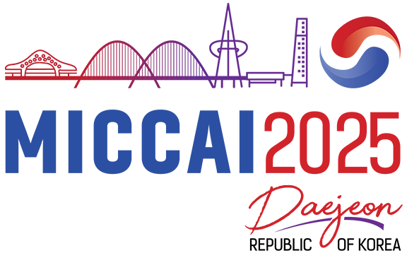
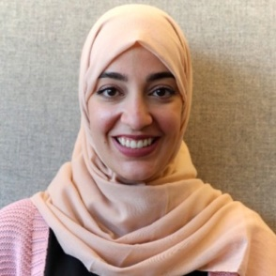

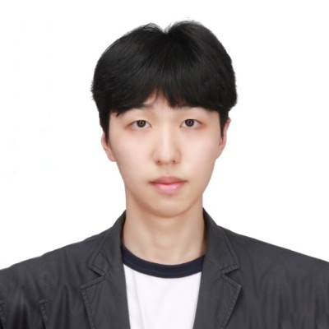




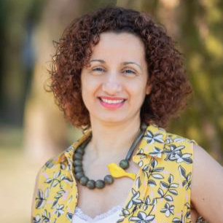
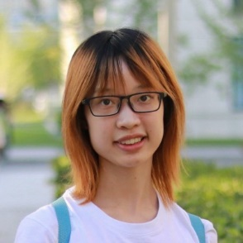
LesionGen: A Concept-Guided Diffusion Model
for Dermatology Image Synthesis
Jamil Fayyad¹
Nourhan Bayasi²
Ziyang Yu³
Homayoun Najjaran¹
ISIC Skin Image Analysis Workshop @ MICCAI 2025
September 23rd, 22025
1 2 3
Notes:
Good morning everyone, my name is Jamil from University of Victoria. Today, it is my pleasure to present LesionGen: A Concept-Guided Diffusion Model for Dermatology Image Synthesis. In this work, we explore how advanced generative models can address one of the most pressing challenges in dermatology, which is the scarcity and imbalance of dermatological data.

Slide 2
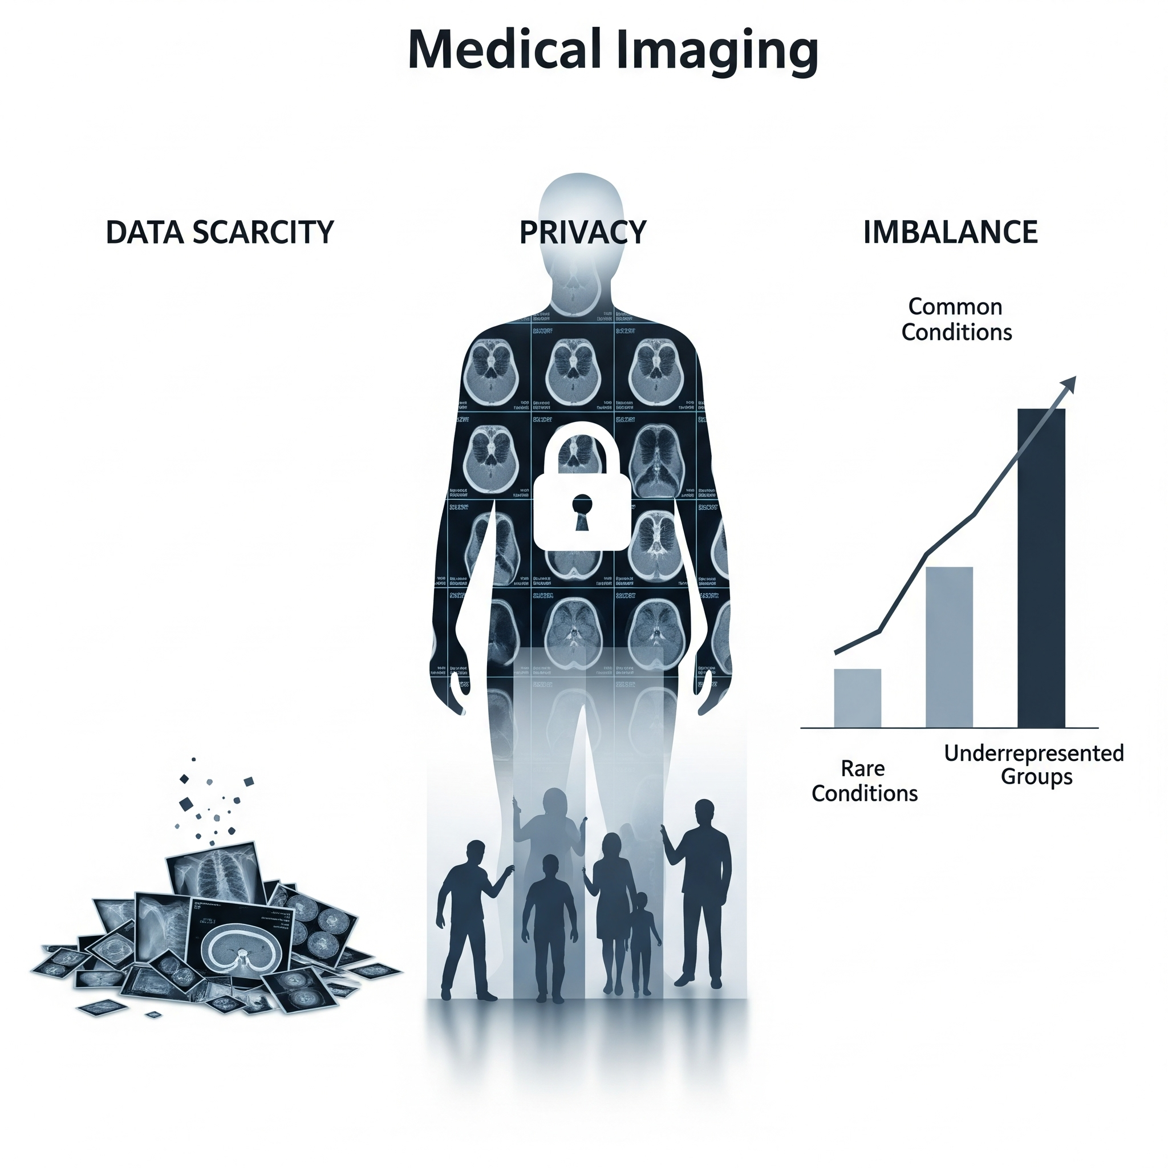
What is the Problem?
Medical Imaging
Common conditions
Underrepresented groups
LesionGen: A Concept-Guided Diffusion Model for Dermatology Image Synthesis
Notes:
As you all know, deep learning has transformed medical image analysis, but it remains highly data-dependent. Dermatology is a particularly challenging case, where accurate diagnosis relies on subtle visual cues that differ across demographics, lighting, and disease progression. Unfortunately, datasets are often small, imbalanced, and restricted by privacy concerns. This creates models that are biased and unreliable in the very settings where they are most needed.

Slide 3
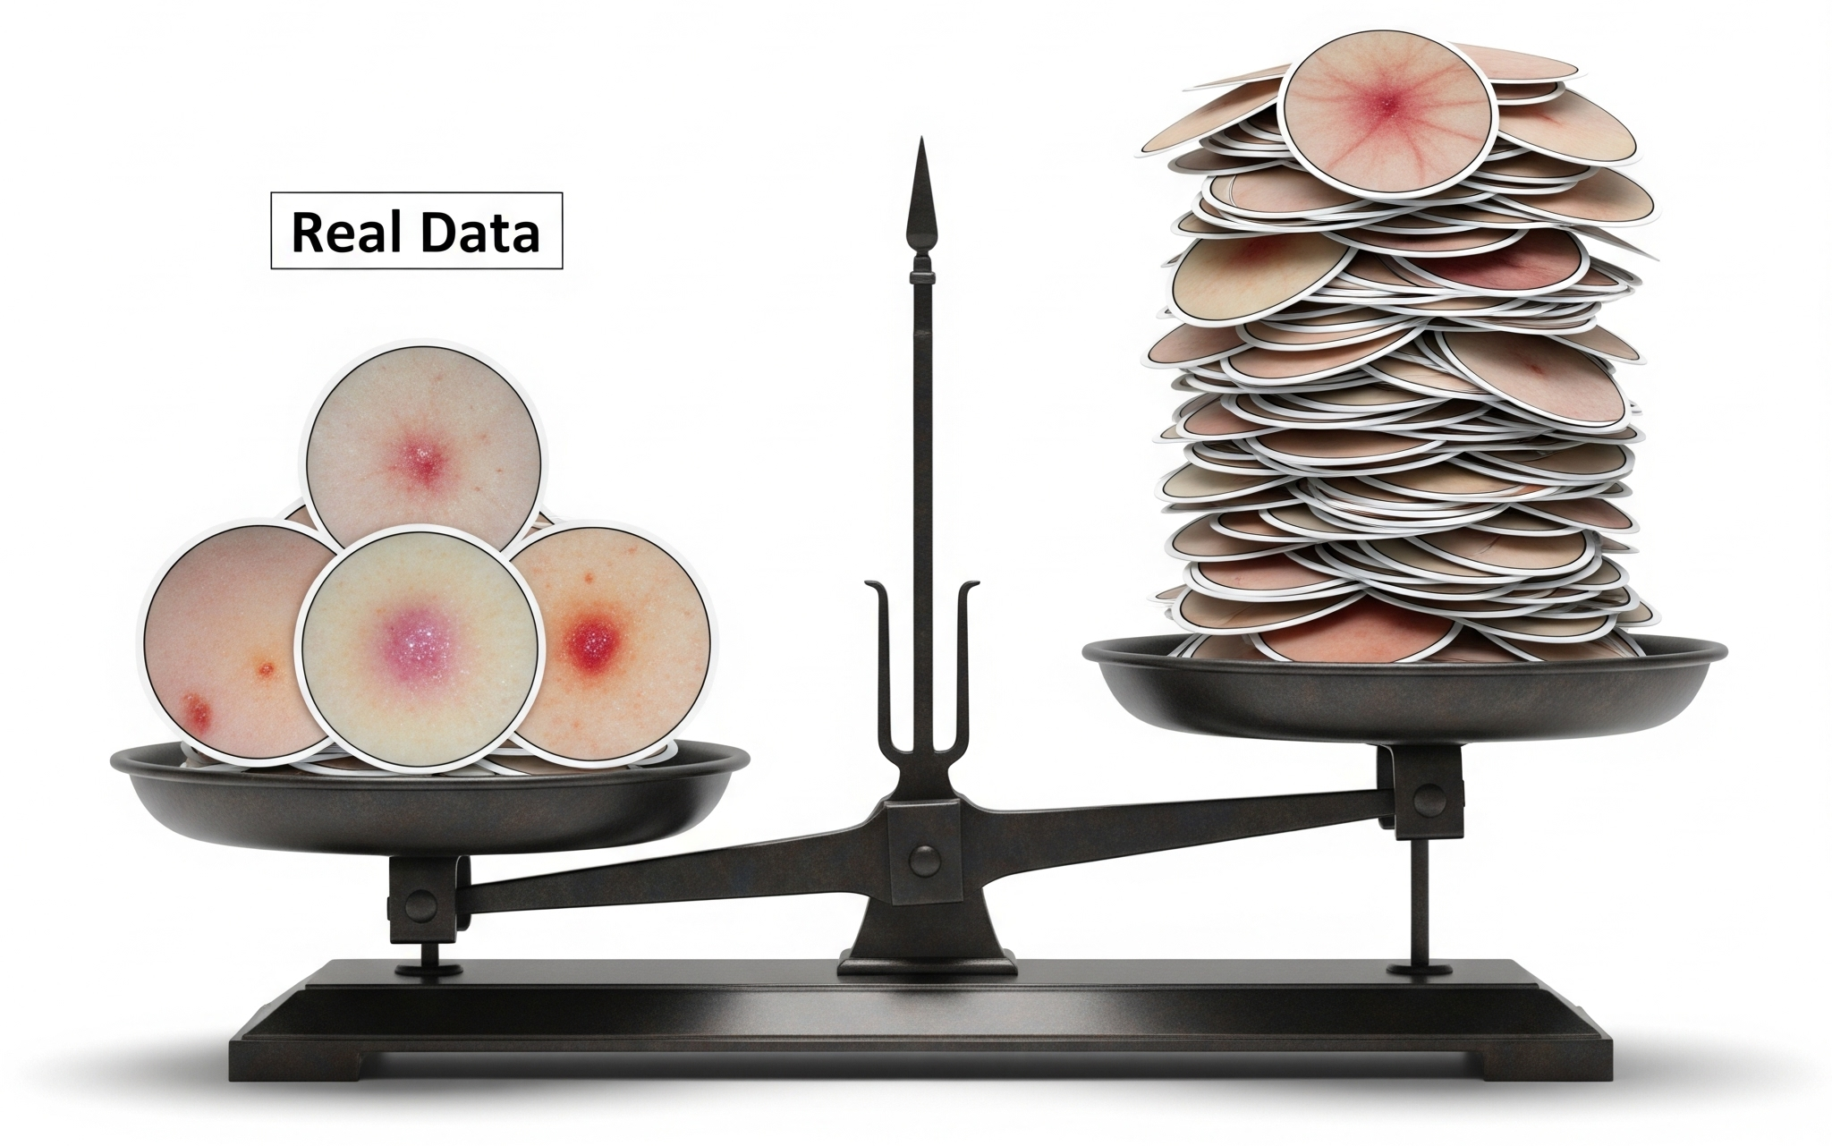
Why Synthetic Data?
Synthetic data:
Fills the gaps
Balances the classes
Is safer than patient data
Synthetic Data
Real Data
LesionGen: A Concept-Guided Diffusion Model for Dermatology Image Synthesis
Notes:
To overcome these barriers, synthetic data has emerged as a promising alternative. By generating new, realistic samples, we can fill gaps in underrepresented classes, reduce reliance on sensitive patient data, and create balanced training distributions. So here, the vision is clear: to supplement scarce medical datasets with safe, diverse, and clinically useful synthetic images.

Slide 4
Prior Work & Its Limitation
Generative models, especially Text-to-Image Diffusion Models, are increasingly applied in medical image synthesis.
In dermatology, a recent method (p-SOTA ^{[1]}) relied only on disease labels only (e.g., “melanoma”) as the text prompt.
Is a single label
really enough
to capture the rich clinical features needed for high-quality images?
[1] Akrout, Mohamed, Bálint Gyepesi, Péter Holló, Adrienn Poór, Blága Kincső, Stephen Solis, Katrina Cirone et al. "Diffusion-based data augmentation for skin disease classification: Impact across original medical datasets to fully synthetic images." In International conference on medical image computing and computer-assisted intervention, pp. 99-109. Cham: Springer Nature Switzerland, 2023.
LesionGen: A Concept-Guided Diffusion Model for Dermatology Image Synthesis
Notes:
However, prior work in dermatology image synthesis has been limited. Most approaches condition image generation on only the disease label such as ‘an image of melanoma’. While this produces visually plausible images, it fails to capture the nuanced clinical attributes that dermatologists rely on, such as pigmentation, lesion elevation, or vascular patterns. Without these details, generated data cannot meaningfully improve diagnostic models

Slide 5
Our Work: LesionGen
Introducing
LesionGen
which utilizes …
Concept-guided text prompt!
LesionGen: A Concept-Guided Diffusion Model for Dermatology Image Synthesis
Notes:
This motivated our work on LesionGen. Our key idea is to move from label-only prompts to concept-guided prompts. By incorporating structured dermatological attributes into text-to-image diffusion models, we can generate images that are not only realistic but also clinically meaningful. Furthermore, we ensure balanced representation across all lesion types, addressing the challenge of class imbalance.

Slide 6
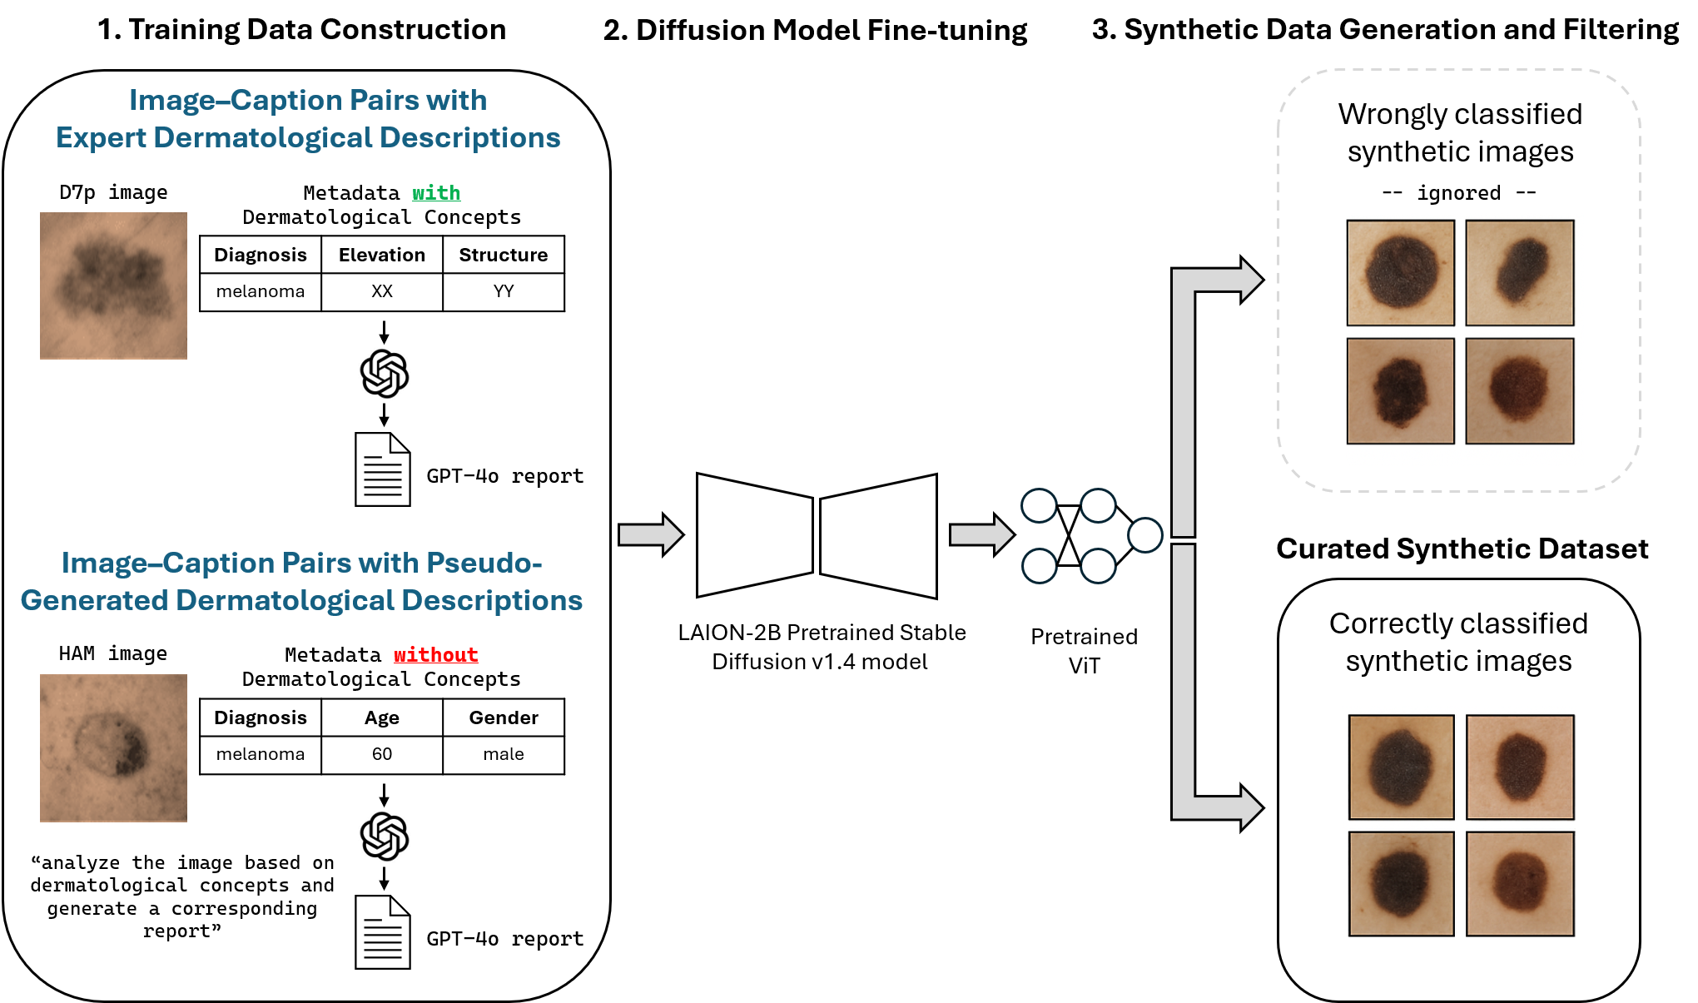
Our Pipeline: 1- Data Construction
First, we construct rich skin lesion image–caption pairs in two ways:
Image-Caption Pairs with Expert Dermatological Descriptions
Dataset: D7P
We use GPT-4o in text-only mode to generate reports from the metadata
LesionGen: A Concept-Guided Diffusion Model for Dermatology Image Synthesis
Notes:
So what did we do exactly? First, we started with curating the image-text dataset, which we will need to guide and finetue the diffusion model with. We constructed rich image–caption pairs in two ways. First, using the D7P dataset, we transformed structured expert annotations into natural-language captions, ensuring that each image was described with seven clinically relevant attributes.

Slide 7
Our Pipeline: 1- Data Construction
First, we construct rich skin lesion image–caption pairs in two ways:
Image-Caption Pairs with Expert Dermatological Descriptions
Image–Caption Pairs with Pseudo-Generated Dermatological Descriptions
Dataset: HAM10000
We use GPT-4o in vision-text mode to generate reports:
By analyzing the image based on visual features
Metadata information
LesionGen: A Concept-Guided Diffusion Model for Dermatology Image Synthesis
Notes:
The second dataset that we used was the HAM10000 dataset, which lacks such detailed dermatologisits annotations. So what we did was that we employed a vision–language model to generate pseudo-captions aligned or guided with those same concepts as in D7P. This strategy allowed us to build a multimodal dataset with consistent, concept-rich descriptions across sources

Slide 8
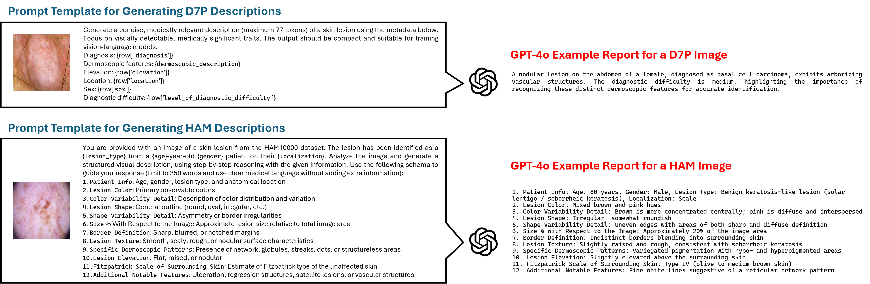
Our Pipeline: 1- Data Construction
LesionGen: A Concept-Guided Diffusion Model for Dermatology Image Synthesis

Slide 9
Our Pipeline: 2- Diffusion Model (DM) Fine-tuning
Second, we fine-tune a pretrained text-to-image DM using a combined set of our expert and pseudo-generated image–caption pairs (from D7P and HAM, respectively).
Stable Diffusion v1.4 - Pretrained on LAION-2B
- Low-Rank Adaptation (LoRA)
LesionGen: A Concept-Guided Diffusion Model for Dermatology Image Synthesis

Slide 10
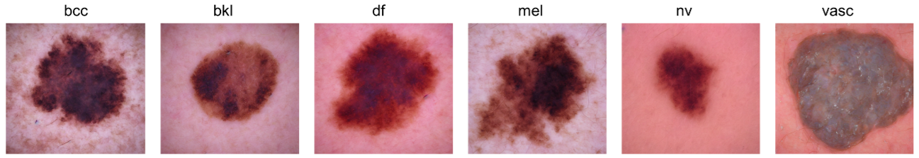
Our Pipeline: 2- Diffusion Model (DM) Fine-tuning
Using the fine-tuned text-to-image DM, we generate …
LesionGen-R&B
Created using Rich & Balanced prompts:
Rich: concept-guided dermatological attributes (pigmentation, elevation, structure…).
Balanced: GPT-4o paraphrasing to equalize class representation.
Result? A class-balanced synthetic dataset with 500 samples/class
LesionGen: A Concept-Guided Diffusion Model for Dermatology Image Synthesis

Slide 11
Our Pipeline: 3- Training a Classifier
Third, and last, we train a downstream classifier on different combinations of the synthetic and real data.
Training dataset per class:
Up to 250 real images (when available)
Supplemented with LesionGen-R&B synthetic images
Final total: 500 samples per class
This configuration is referred to as (synth+real)
Evaluation:
Held-out real test sets from D7P and HAM
LesionGen: A Concept-Guided Diffusion Model for Dermatology Image Synthesis

Slide 12
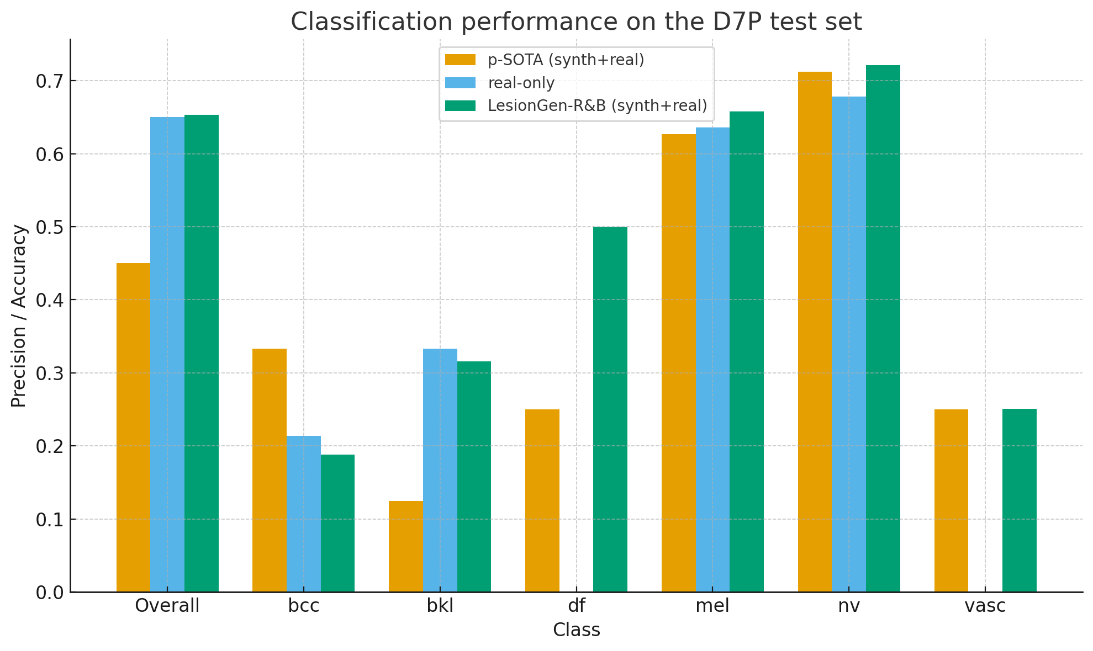
Main Results
Classification performance on the D7P test set, reported by overall accuracy and per-class precision.
LesionGen: A Concept-Guided Diffusion Model for Dermatology Image Synthesis

Slide 13
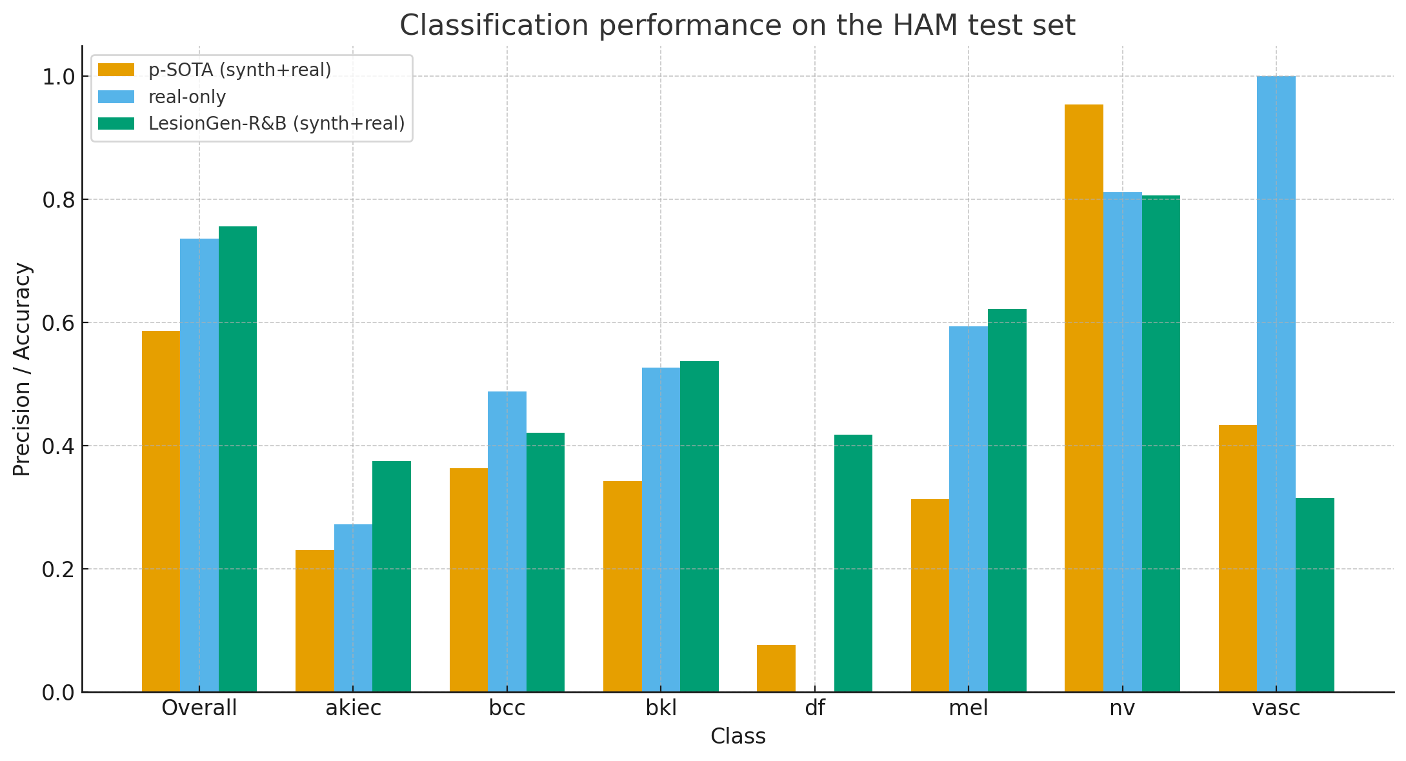
Main Results
Classification performance on the HAM test set, reported by overall accuracy and per-class precision.
LesionGen: A Concept-Guided Diffusion Model for Dermatology Image Synthesis

Slide 14
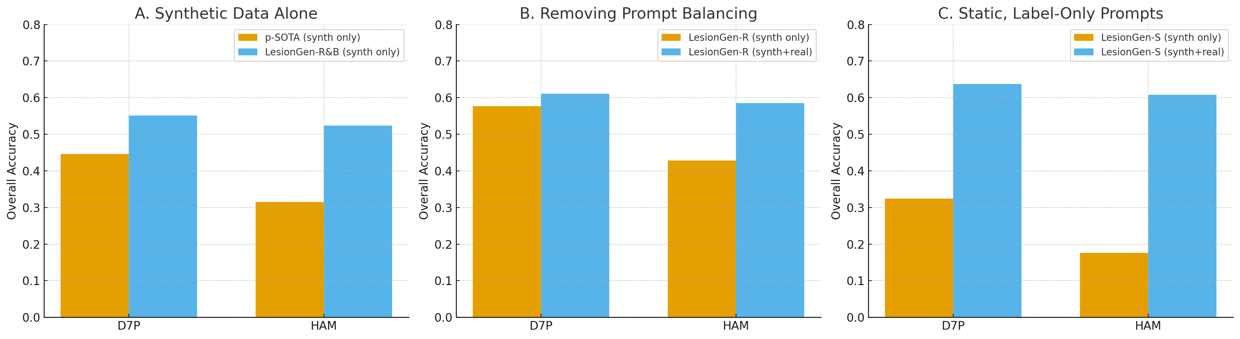
Ablation Studies
Ablation study A evaluates the impact of using synthetic data alone.
Ablation study B evaluates the impact of removing prompt balancing.
Ablation study C evaluates the impact of using static, label-only prompts.
LesionGen: A Concept-Guided Diffusion Model for Dermatology Image Synthesis
Notes:
Ablation study A evaluates the impact of using synthetic data alone, showing that while performance drops compared to synth+real, LesionGen-R&B still produces much higher accuracy than p-SOTA.
Ablation study B evaluates the impact of removing prompt balancing, showing that without balancing, majority classes perform well but minority classes collapse, leading to inconsistent overall accuracy.
Ablation study C evaluates the impact of using static, label-only prompts, showing that without rich descriptions accuracy drops sharply and even with synth+real the results lag behind the rich and balanced configuration.

Slide 15


Thanks for listening!
LesionGen: A Concept-Guided Diffusion Model for Dermatology Image Synthesis

